Slide 1
Introduction of P2P systems

Slide 2
What is P2P Systems
Definition:
Significantly autonomous from a centralized authority.
  Each node can act as a Client as well as a Server.
Use the vast resources of machines at the edge of the internet.
  Storage, content, CPU power, Human presence.
Resources at edge have intermittent connectivity, being added & removed.
  Infrastructure is untrusted and the components are unreliable.

Slide 3
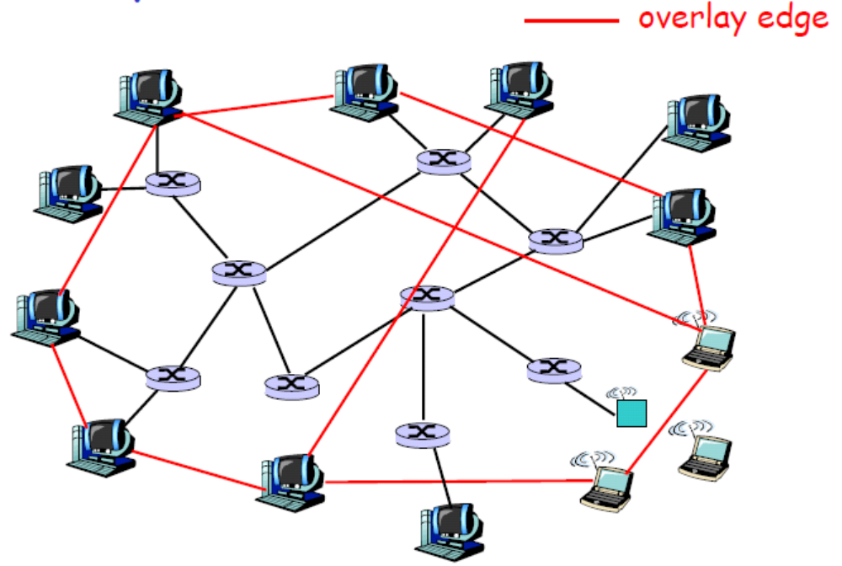
Overlay Network
A P2P network is an overlay network. Each link between peers consists of one or more IP links.

Slide 4
Overlay Graph
Virtual edge
  TCP connection
  or simply a pointer to an IP address
Overlay maintenance
  Periodically ping to make sure neighbor is still alive
  Or verify aliveness while messaging
  If neighbor goes down, may want to establish new edge
  New node needs to bootstrap
  Could be a challenge under high churn rate
    Churn --

Slide 5
More about Overlays
Tremendous design flexibility
  Topology, maintenance
  Message types
  Protocol
  Messaging over TCP or UDP
Underlying physical net is transparent to developer
Unstructured overlays
  e.g., new node randomly chooses three existing nodes as neighbors
Structured overlays
  e.g., edges arranged in restrictive structure

Slide 6
P2P Applications
P2P File Sharing
  Napster, Gnutella, Kazaa, eDonkey, BitTorrent
  Chord, CAN, Pastry/Tapestry, Kademlia
P2P Communications
  MSN, Skype, Social Networking Apps
P2P Distributed Computing
  Seti@home

Slide 7
P2P File Sharing
Alice runs P2P client application on her notebook computer Intermittently connects to Internet
Gets new IP address for each connection
Asks for “Hey Jude”
Alice chooses one of the peers, Bob.
Application displays other peers that have a copy of Hey Jude.
File is copied from Bob’s PC to Alice’s notebook
While Alice downloads, other users may upload from Alice.
P2P
P2P

Slide 8
P2P Communication
Instant Messaging
Skype is a VoIP P2P system
Alice runs IM client application on her notebook computer Intermittently connects to Internet
Gets new IP address for each connection
Register herself with “system”
Alice initiates direct TCP connection with Bob, then chats
Learns from “system” that Bob in her buddy list is active
P2P

Slide 9
P2P Distributed Computing
seti@home
  Search for ET intelligence
  Central site collects radio telescope data
  Data is divided into work chunks of 300 Kbytes
  User obtains client, which runs in background
  Peer sets up TCP connection to central computer, downloads chunk
  Peer does FFT on chunk, uploads results, gets new chunk
Not P2P communication, but exploit Peer computing power

Slide 10
Promising properties of P2P
Massive scalability
Autonomy : non single point of failure
Resilience to Denial of Service
Load distribution
Resistance to censorship

Slide 11
What can be Issue?
Management
  How to maintain the P2P system under high churn efficiently?
Lookup
  How to find out the appropriate content/resource what a user wants?
Throughput
  How to copy the content fast and efficiently?

Slide 12
Management Issue
A P2P network must be self-organizing.
  Join and leave operations must be self-managed.
  The infrastructure is untrusted and the components are unreliable.
  The number of faulty nodes grows linearly with system size.
  Tolerance to failures and churn
Efficient routing even if the structure of the network is unpredictable.
Dealing with freeriders
Load balancing

Slide 13
Napster
Centralized Lookup
  Centralized directory services
  Step
    Connect to Napster server.
    Upload list of files to server.
    Give server keywords to search the full list with.
    Select “best” of correct answers. (ping)
  Bottleneck of the performance
Lookup is centralized, but files are copied in P2P manner

Slide 14
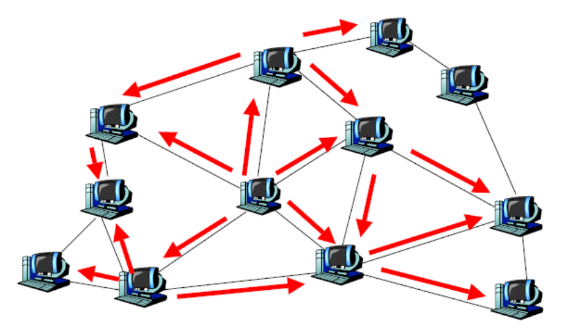
Gnutella
Fully decentralized lookup for files
  Unstructured P2P
  Flooding based lookup
  Obviously inefficient lookup in terms of scalability and bandwidth

Slide 15
Gnutella Scenario
Step 0: Join the network
Step 1: Determining who is on the network
  "Ping" packet is used to announce your presence on the network.
  Other peers respond with a "Pong" packet.
  Also forwards your Ping to other connected peers
  A Pong packet also contains:
    an IP address
    port number
    amount of data that peer is sharing
    Pong packets come back via same route
Step 2: Searching
  Gnutella "Query" ask other peers if they have the file you desire A Query packet might ask, "Do you have any content that matches the string ‘Hey Jude"?
  Peers check to see if they have matches & respond (if they have any matches) & send packet to connected peers
  Continues for TTL (how many hops a packet can go before it dies )
Step 3: Downloading
  Peers respond with a “QueryHit” (contains contact info)
  File transfers use direct connection using HTTP protocol’s GET method

Slide 16
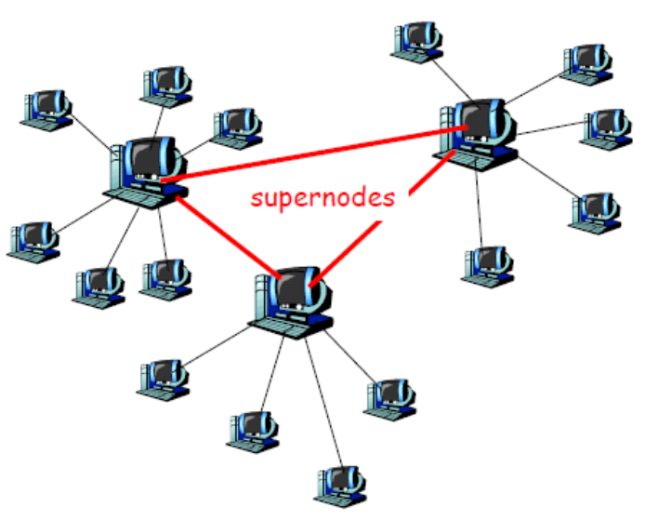
KaZaA
Hierarchical approach between Gnutella and Napster
  Powerful nodes (supernodes) act as local index servers, and client queries are propagated to other supernodes. Two-layered architecture.
  Each supernode manages around 30-50 nodes
  More efficient lookup than Gnutella and more scalable than Napster

Slide 17
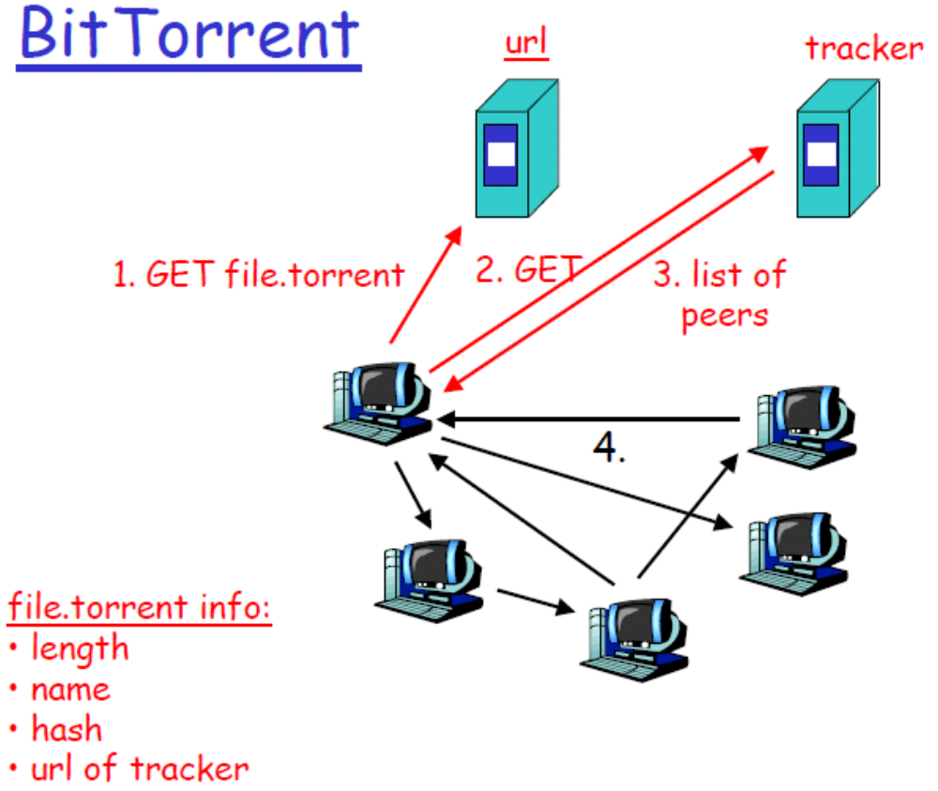
BitTorrent
Sharing large volume of files faster and more efficiently
Maximizing the utilization of bandwidth

Slide 18
BitTorrent : Pieces
File is broken into pieces
  Typically piece is 256 KBytes
  Upload pieces while downloading pieces
Piece selection
  Select rarest piece
  Except at beginning, select random pieces
Tit-for-tat
  Bit-torrent uploads to at most four peers
  Among the uploaders, upload to the four that are downloading to you at the highest rates
  A little randomness too, for probing
  MORE DETAIL…..EXAMPLES….

Slide 19

Structured P2P
Peer-to-peer hash lookup:
  Node ID(Key) , Object ID(Key)
  Lookup(key) → IP address
How does these route lookups?
How does these maintain routing tables?
K V
K V
Chord,
Pastry,
Tepastry,
Can,
Kademlia,
etc
K V
K V
K V
K V
K V
K V
K V
K V
insert
(K₁,V₁)
K V
retrieve (K₁)

Slide 20
Consistency Hashing
Overlay network often has a known structure (ring)
Each node has randomly chosen id
  Keys in same id space
Node’s successor in circle is node with next largest id
  Each node knows IP address of its successor
Object Key is stored in closest successor

Slide 21
Chord
Key 5
K5
Node 105
N105
K20
Circular 7-bit
ID space
N32
N90
K80
A key is stored at its successor: node with next higher ID

Slide 22
Chord
112
N5
N120
N10
K19
½
N110
¼
N20
N99
N32
1/8
Lookup(K19)
1/16
1/32
1/64
N80
1/128
N80
N60
Finger i points to successor
of n+2i
Lookups take O(log(N)) hops

Slide 23
CAN
Virtual Cartesian coordinate space
entire space is partitioned amongst all the nodes
  every node “owns” a zone in the overall space
abstraction
  can store data at “points” in the space
  can route from one “point” to another
point = node that owns the enclosing zone
3
3
1
2
1
1
1
2
2
4

Slide 24
CAN
A node only maintains state for its immediate neighboring nodes
O(n^{1/d})
(a,b)
(x,y)

